Slide 1
JIG Learning From Incidents (LFIs) Toolbox Meeting Pack Pack 19 - November 2016
This document is made available for information only and on the condition that (i) it may not be relied upon by anyone, in the conduct of their own operations or otherwise; (ii) neither JIG nor any other person or company concerned with furnishing information or data used herein (A) is liable for its accuracy or completeness, or for any advice given in or any omission from this document, or for any consequences whatsoever resulting directly or indirectly from any use made of this document by any person, even if there was a failure to exercise reasonable care on the part of the issuing company or any other person or company as aforesaid; or (B) make any claim, representation or warranty, express or implied, that acting in accordance with this document will produce any particular results with regard to the subject matter contained herein or satisfy the requirements of any applicable federal, state or local laws and regulations; and (iii) nothing in this document constitutes technical advice, if such advice is required it should be sought from a qualified professional adviser.

Slide 2
Learning From Incidents How to use the JIG Toolbox Meeting Pack
The intention is that these slides promote a healthy, informal dialogue on safety between operators and management
Slides should be shared with all operators (fuelling & depot operators and maintenance technicians) during regular, informal safety meetings
No need to review every incident in one Toolbox meeting. Select 1 or 2 incidents per meeting
The supervisor or manager should host the meeting to aid the discussion, but should not dominate the discussion
All published packs can be found in the publications section of the JIG website at
www.jigonline.com

Slide 3
Learning From Incidents For every incident in this pack, ask yourself the following…
What is the potential for a similar type of incident at our site?
How do our risk assessments identify and adequately reflect these incidents?
What prevention measures are in place (procedures and practices) and how effective are they?
What mitigation measures are in place (safety equipment/emergency procedures) and how effective are they?
What can I do personally to prevent this type of incident?
If you would like further assistance or information relating to the contents of this pack,
or if you have any information you feel will help avoid the reoccurrence of such incidents, then please contact JIG at
http://www.jigonline.com/contacts/

Slide 4
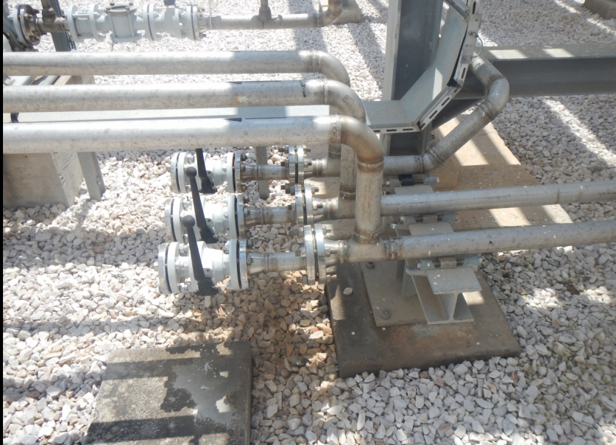
Spill due to flange gasket failure 2016-14
Incident Summary
A small spill was observed while an Operator was carrying out a periodic safety inspection within the bunded areas of the airport depot fuel farm. He realised that the colour of the gravel under the 2” flanges had changed. On close inspection he observed that fuel droplets were leaking from one of the 3 flanges (see photo) due to a failed gasket. The said pipe was a part of the bottom drain line from one of the storage tanks that was connected to the tanks’ centralised sampling system. He depressurised the fuel pipe and stopped the leak.
Causes
Following incident investigation, it was observed that the thermal relief valve (TRV) was never designed/installed for the tank drain lines although installed elsewhere. It was decided to install a TRV and modify the tanks’ drain lines so that all of them can be thermal released by the same TRV. P & I D drawings revised.
Toolbox Discussion Points
Would small spills of this nature be reported and suitably acted upon?
Always follow safety inspection procedures. Remember that you get not what you expect, but what you inspect.
Do you try to find the root cause of an incident?
Is an incident investigation carried out after every incident?
Have HAZOPs been performed on your site and are they reviewed? Do you update the risk assessment after an incident investigation?
Can you think of a similar situation that you have experienced or witnessed and did you report it?

Slide 5
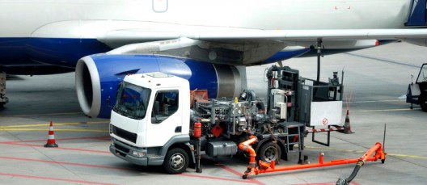
Operator faces hostility from pilot 2016-15
Incident Summary
An operator received a fuel request from a ramp agent for a specified quantity of fuel for a flight that had just arrived and was due to depart soon after. The flight was due a crew change but the replacement pilot’s inbound flight was delayed. In order to avoid delaying the outbound flight. the ramp agent and replacement first officer oversaw the fuelling of the aircraft in preparation for departure. As the operator prepared to fuel, the pilot being replaced approached and asked for ‘full wings’ without checking the flight plan. The operator queried the change request with the ramp agent but the pilot repeatedly intervened insisting on ‘full wings’. The operator stayed calm and applied the agreed procedure which was to accept the request received from the ramp agent. When the replacement pilot eventually arrived he confirmed that the fuel request received from the ramp agent was the required volume for the flight plan and thanked the operator for his actions.
Causes
The pilot being replaced did not follow agreed procedures
Toolbox Discussion Points
What could have been the potential consequences of loading more than the required fuel onto the aircraft?
Do your staff have the skills required to defuse a situation? e.g. keeping calm, controlling own body language, avoiding entering physical space, listening and questioning to better understand the reason for the hostility
Would your staff feel sufficiently empowered to follow the approved process under pressure from customers?
Can you think of a similar situation that you have experienced or witnessed and did you report it?

Slide 6
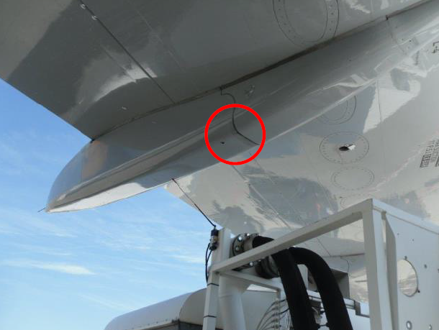
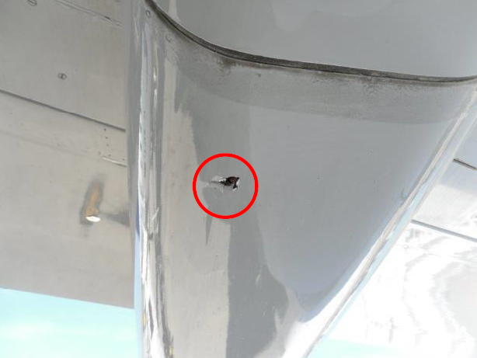
AC Damage while raising elevating platform (AC Damage) 2016-16
Incident Summary
An Operator carried out a deck hose fuelling operation with a refuelling truck. In order to connect the deck hose, he raised the platform. When at the correct height, the platform control device did not stop the upward movement. The Operator stopped the upward movement by using the emergency stop but the wand sensor made contact with the wing flap trap fairing and punctured a small hole in it.
Causes
The design of the pneumatic control safety circuit was found to be unsuitable. The wand (high limiter) sensor, the emergency stop and the control device for the lift platform are connected in series via a line to the compressed air tank. If the wand sensor reacts and the manual device is stopped by the Operator at the same time, the compressed air supply does not release quickly enough to stop the platform movement immediately.
Action Taken
Pneumatic control circuit has been modified so that the air line to the emergency stop and wand device is separate from the airline to control the platform lift. All vehicles with platforms have been checked, modified where necessary and stop devices tested.
Toolbox Discussion Points
Do you have sufficient understanding of the design of equipment being used to be sure that this could not
occur at your location?
Can you think of a similar situation that you have experienced or witnessed and did you report it?

Slide 7
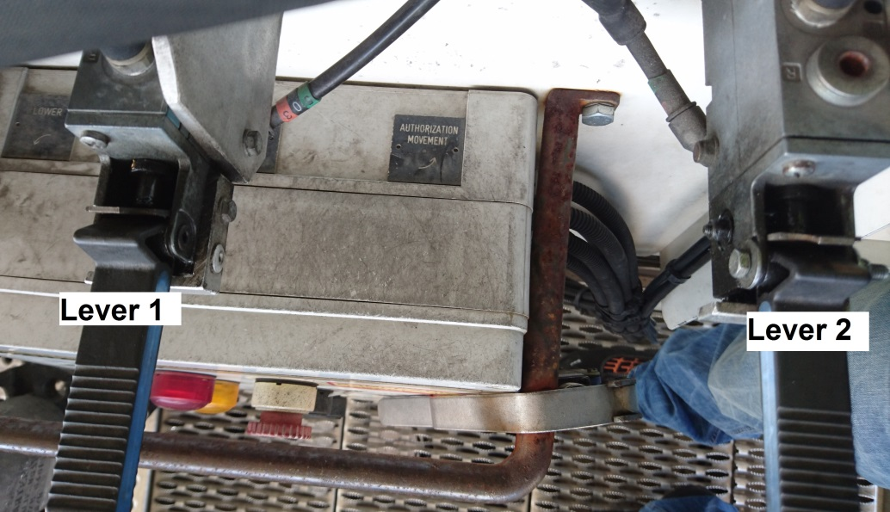
Spill & AC damage while raising elevating platform LFI 2016-17
Incident Summary
After completing an Airbus 330 fuelling the operator raised the elevating platform to access the fuelling couplings for disconnection. While raising the platform one of the fuelling hoses became trapped between the two (raise and lower) platform control levers. The hose pushed against the levers resulting in further unintentional raising of the platform. Once the wing wand touched the aircraft the movement was stopped. The bending force created on the hose by the handrail resulted in a breakaway at the predetermined points of the aircraft adaptor. Around 25 litres of Jet A-1 was spilled from the hose onto the apron and an underwing scratch was identified as a result of the incident. The aircraft was able to depart as scheduled.
Causes
Incorrect fueller position under aircraft – platform not positioned under fuelling connections resulting in bending of the hose over the handrail.
Incorrectly positioned elevating platform control levers – The risk of a stuck hose was not considered while installing the levers - a protection bar to avoid unintended activation is needed.
Inefficient Wing Wand – The emergency stop preventing the elevating platform to be too close to the wing was activated when the platform was too high, resulting in a bending stress of the hose and break away.
Toolbox Discussion Points
Are fuellers positioned correctly to ensure hoses are lined up to hang freely?
Is unintended activation of the platform a possible incident scenario?
Would a single lever control have avoided this incident?
Can you think of a similar situation that you have experienced or witnessed and did you report it?

Slide 8
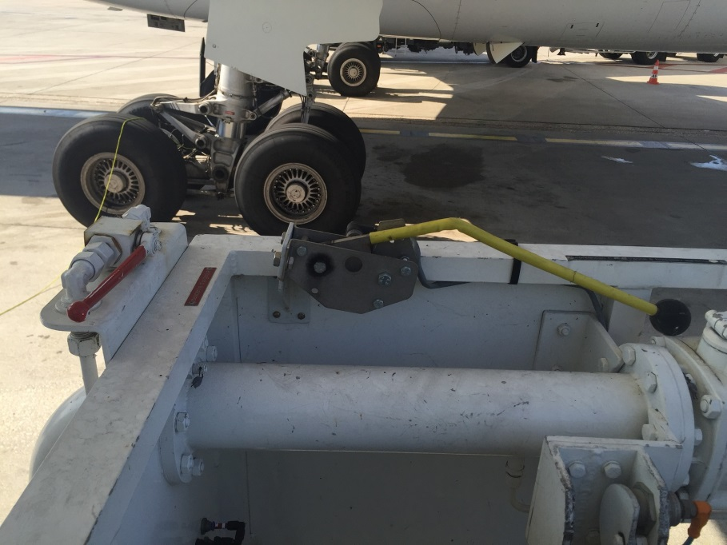
Aircraft damage while raising elevating platform LFI 2016-18
Incident Summary
In preparation of an Airbus 340 refuelling the operator raised the elevating platform to access the aircraft couplings. When the lever was released the elevating platform did not stop. The operator tried several times without result. Also the engaged wing wand did not stop the platform and the operator had to use the emergency button. By the time the platform stopped it had scratched the aircraft. Aircraft was delayed.
Causes
A faulty hydraulic power case was identified - corrosion due to adverse weather condition
The control lever and the wing wand switch are not independent from each other
Location of the emergency stop button (ESB) was not in near area of where the operator is positioned when raising the platform, this resulted in delayed activation of the ESB.
After the operator found the control not functioning correctly he re-tried several times instead of using the ESB directly without losing time on the faulty control
Toolbox Discussion Points
Are elevating platform controls maintained and inspected to ensure good working condition
Are ESB’s installed such that they can be operated easily and without delay in case of need, are they easily identified
Are operators aware of the position of the ESB, when to use and how to test them
Can you think of a similar situation that you have experienced or witnessed and did you report it?

Slide 9
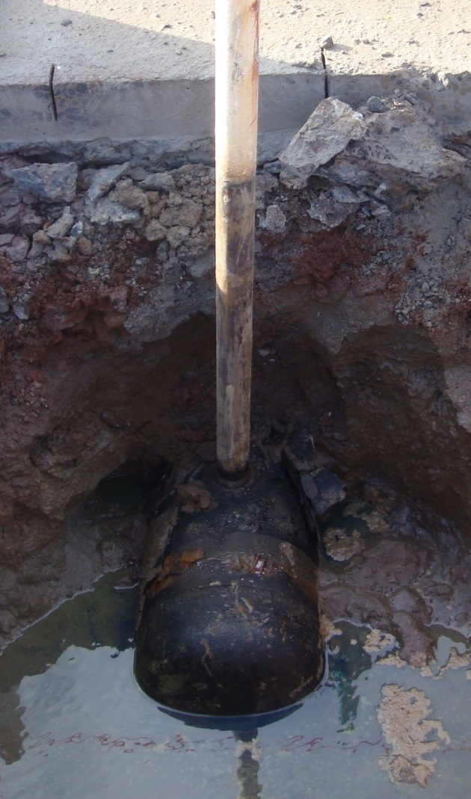
Spill during pipeline pressure testing LFI 2016-19
Incident Summary
A periodic pressure test of underground pipework was initiated to confirm pipework integrity. The test procedure is to observe the 120 psi test pressure for 4 hours. After 2 hours a sudden loss of pressure was identified. No visual indication of leakage was found. After checking the equipment it was concluded that an underground leakage could have occurred. Possible solutions on how to deal with the incident were discussed. Pipework isolations to further narrow the location of the leak were installed. The remaining fuel was removed from the underground pipework.
Causes
Cause of pipe failure not known at this stage
Site was not prepared for this spill event– Emergency response was not defined
Lack of contractor management around test methods used and emergency preparedness
Toolbox Discussion Points
Do you have any underground pipework or equipment that could release product?
In case this happened at your site would your emergency response be effective? Does your emergency plan consider spills from underground sources? Do you coordinate emergency procedures with contractors?
Can you think of a similar situation that you have experienced or witnessed and did you report it?

Slide 10
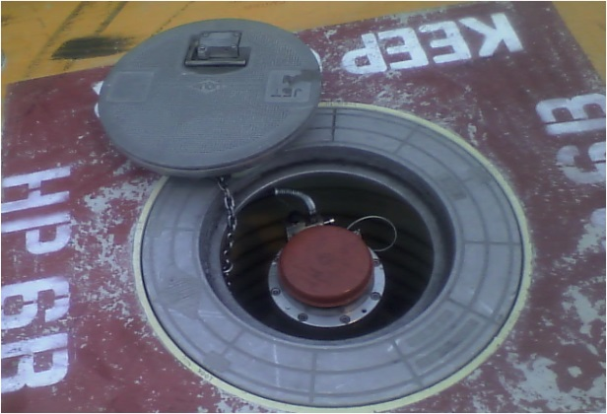
Manual Handling Injury LFI 2016-20
Incident Summary
An Operator was removing a composite hydrant pit lid, lost grip of the handle and trapped a finger in between the lid and the ground. This resulted in a fracture of the top of the finger. There was no evidence of other factors contributing to the incident such as fatigue, use of drugs or alcohol or external / personal circumstances. Appropriate first aid was provided very soon after the incident occurred that prevented further potential complications associated with swelling.
Causes
The Operator adopted an incorrect manual handling technique and body position for the task. The free hand was positioned horizontally on the ground rather than positioned on the knee and the movement of the pit lid was across the body rather than to the right (lifting hand) side. Complacency may have set in on this regular task.
There was no external visual indication of pit lid tether location, which can cause snagging when lifting the lid.
Toolbox Discussion Points
Are the positions of pit lid tethers on hydrant pit lids marked to avoid instances of snagging while lifting. If not, could this be discussed with the Airport Authority?
How can you avoid complacency and continuously adopt the correct manual handling technique when lifting hydrant pit lids?
Are Supervisors spending sufficient time on the apron to witness pit lid lifting operations and to provide feedback to the Operators if incorrect manual handling techniques are being applied?
Are you sufficiently familiar with what to do in the event of a medical emergency.
Can you think of a similar situation that you have experienced or witnessed and did you report it?

Slide 11
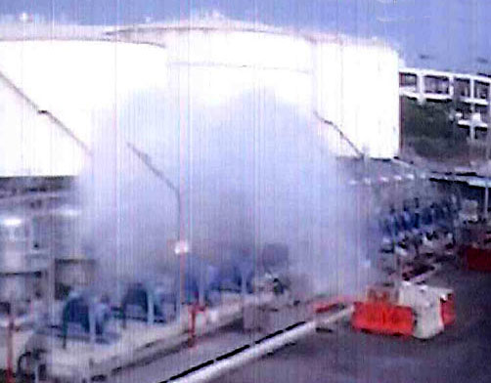
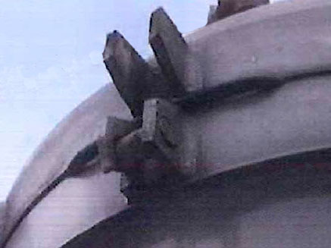
FWS seal failure due to excessive surge pressure 2016-21
Incident Summary
A hydrant extension was being flushed into vehicles during commissioning and valves on a temporary manifold connected to the hydrant riser were closed too rapidly; this caused caused excessive surge pressures and resulted in a mist cloud and a 2000-3000 litre spill from one of the into-hydrant Filter Water Separator (FWS) dome seals – one of the lid bolts, which was different to the others, failed causing the dome seal to be dislodged. Another bolt became loose, but all the other bolts were in good condition.
Causes
Valve closure times on the flushing manifold were not calculated to ensure that high surge pressures were not generated.
The hoses to the vehicles were downstream of the manifold valves so they were unable to provide any surge pressure attenuation.
The failed bolt, which was different to all the other bolts, sheared off at the weld between the threaded shaft and the head.
Standard bolt on vessel
Toolbox Discussion Points
Would an effective Management of change (in this case the change of bolt) process have helped avoid this incident?
If flushing a hydrant into vehicles or temporary storage is required are hydrant surge pressures calculated and minimised?
Are filter vessel lid bolts procured from the equipment supplier?
If such bolts require replacement is the whole set replaced?
Are lid bolts tightened to a set torque advised by the manufacturer?
Jet mist cloud
Weld failure

Slide 12
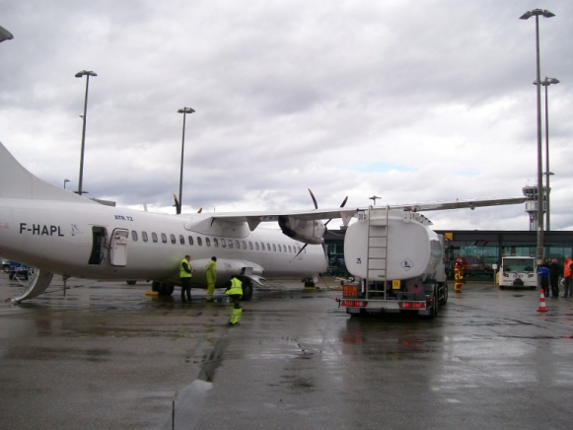
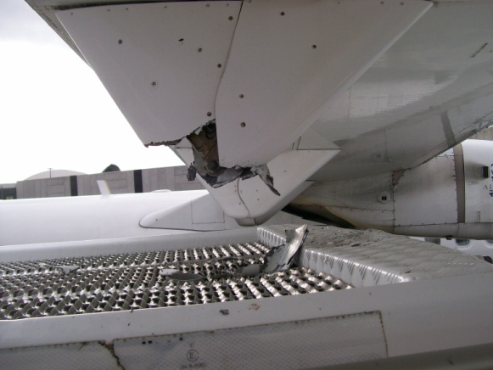
Aircraft Incident – Fueller hits aircraft LFI 2016-22
Incident Summary
A trainee operator on his second standalone driving day was being supervised by his trainer who was following him in a light vehicle. As the operator approached the aircraft his trainer asked him over the radio what he thought about his positioning. The trainee didn’t understand the purpose of the question and kept on driving in the same direction. His vehicle hit the right wing (flap track fairings) of the plane. The scheduled flight had to be cancelled.
Causes
Ineffective training - Trainee not having been trained and tested over a sufficient period of time to be fully confident in his new standalone refuelling activity.
Ineffective communication – The trainer did not communicate effectively enough to avoid the incident
Toolbox Discussion Points
How can we be assured that a trainee has reached the required skill level before operating independently? How is this managed/authorised?
What procedure may be implemented to ensure drivers know the under wing height features of each type of plane before leaving the depot thus avoiding all collision risks ? Do you really know the standard procedure when approaching airplane parking areas?
How could the communication have been improved in this situation? How is supervision performed for other standalone activities performed in the training period?
Can you think of a similar situation that you have experienced or witnessed and did you report it?

Slide 13
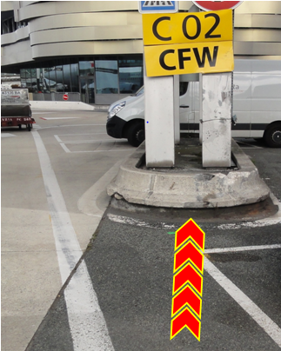
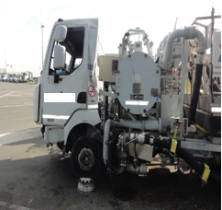
Vehicle Incident
LFI 2016 - 23
Incident Summary
An Operator was on his way back from the apron after completing the second daily refuelling operation. The driver overran a stop sign and after travelling 200 meters hit a low concrete wall then a post of a building near a parking area. Fortunately the operator was wearing his seatbelt preventing him from a more severe injury although it did result in an LTI. The fuelling vehicle, severely damaged, could not be moved holding up the traffic.
The Operator wasn’t using any distracting devices (e.g. radio) when driving and the road along the airport is wide and the traffic was light at the time of the incident.
Causes
The Operator said he had no recollection of the incident.
Sleep could have been a cause as there were no visible braking marks on the road. However he had just come off a rest period.
Toolbox Discussion Points
With operators, discuss about role and importance of fastening seatbelts even at low speed. What checks do you perform to ensure they always wear their seatbelt?
What medical assessments do personnel have before starting employment to ensure their fitness for the activities required of them? What health surveillance is performed to ensure their ongoing fitness?
Do you undertake defensive driving training? Does this include the topic of fatigue?
Can you think of a similar situation that you have experienced or witnessed and did you report it?

